Slide 1

DriverPass System Analysis
Reginald Cooper
Notes:
[No speaker notes required for this slide.]

Slide 2

System Requirements
Functional Requirements:
User Authentication
Online Test Scheduling
Nonfunctional Requirements:
System Performance
Security
Notes:
Functional:
The system should allow users to register, log in, and log out. This feature is crucial to ensure that only authorized users can access the system, such as students, instructors, and administrators. This functional requirement is essential for maintaining the integrity of the user data and providing personalized experiences.
The system should allow students to schedule driving tests online. This feature helps automate the process of booking test slots, reducing the workload on administrative staff and making it convenient for students.
Nonfunctional:
The system should be able to handle a large number of simultaneous users without performance degradation. This is crucial for ensuring that users have a smooth experience, especially during peak times when many students might be trying to book test slots.
The system must ensure that user data, such as personal information and test results, is stored securely. This nonfunctional requirement is critical for protecting sensitive information and ensuring compliance with data protection regulations.
In developing the DriverPass system, I focused on key functional requirements to making sure it meets the needs of its users. First, user authentication is crucial because it make sure that only authorized personnel can access sensitive features of the system. This is vital for maintaining the security and privacy of user information. Also, the online test scheduling feature is designed to streamline the booking process, making it more accessible and efficient for students, which directly aligns with DriverPass's objectives.
On the nonfunctional side, system performance is a top priority for me, as it is essential for providing a smooth user experience, especially during periods of high traffic. Guaranteeing that the system remains responsive under load is critical. Also, security is indispensable in protecting user data, which I recognize as both a legal and ethical responsibility for DriverPass.
These requirements are composed to make sure that the DriverPass system is not only functional but also robust, meeting the expectations of its users and stakeholders.

Slide 3
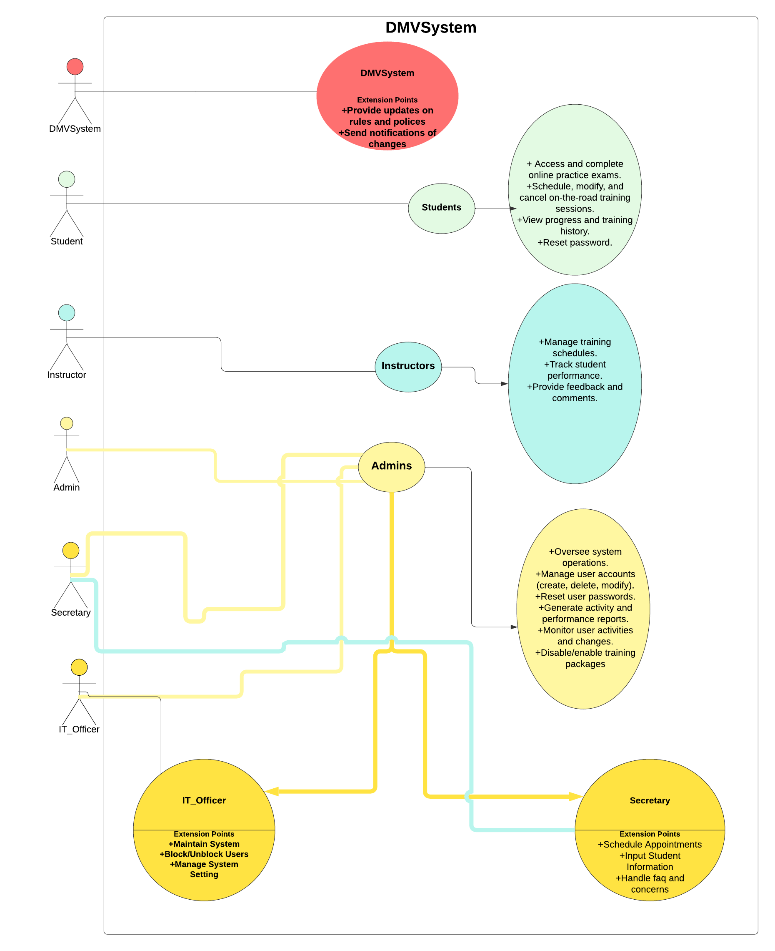
Use Case Diagram
Notes:
In my diagram, I’ve shown how the system works to meet the needs of different people involved in the DriverPass program. The key individuals using this system include students, instructors, admins, IT officers, and secretaries, each of whom interacts with the system in unique ways.
For students, the system allows them to access and complete online practice exams, schedule and modify on-the-road training sessions, and view their progress and training history. This make sure that students have the tools they need to prepare effectively for their driving tests.
Instructors can manage their training schedules, track student performance, and provide feedback and comments. This design supports instructors in effectively guiding students through their training.
Admins are responsible for overseeing system operations, managing user accounts, and generating reports. The system supports their role by enabling them to monitor activities, reset passwords, and manage user permissions.
IT officers focus on maintaining the system, blocking or unblocking users, and managing system settings, ensuring the system runs smoothly and securely.
Secretaries are tasked with scheduling appointments, inputting student information, and handling frequently asked questions and concerns. The system helps secretaries efficiently manage these tasks to keep the program running smoothly.
In designing this system, I made sure that each role’s needs were carefully considered and addressed, making sure that the system supports the overall goals of DriverPass by providing each user with the tools and information they need to succeed.

Slide 4
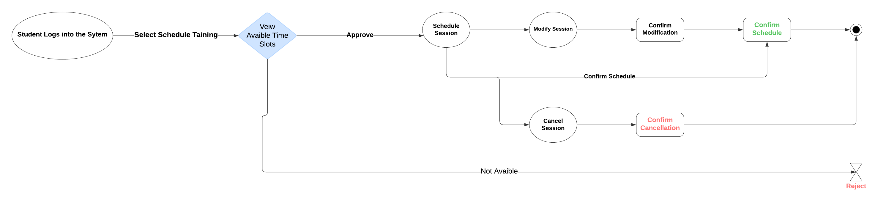
Activity Diagram
Notes:
I'm breaking down the process a student goes through to schedule, modify, or cancel an on-the-road training session with DriverPass. Here’s how the process unfolds:
1. Logging into the System: The student starts by logging into the system.
2. Selecting a Training Session: After logging in, the student chooses the option to schedule a training session.
3. Viewing Available Time Slots: The system then shows the student the available time slots for their training. If the student finds a suitable time, they proceed to approve it.
4. Scheduling the Session: Once a time slot is approved, the session is scheduled.
5. Modifying the Session: If the student needs to change the time of the session, they can modify the session details. This modification is then confirmed by the system.
6. Confirming the Schedule: After scheduling or modifying the session, the system confirms the final schedule with the student.
7. Canceling the Session: If for some reason the student needs to cancel the session, they can do so. The system will then confirm that the cancellation has been completed.
8. Session Unavailable: In cases where the student does not find a suitable time slot, the system will indicate that there are no available times and will reject the scheduling process.
In designing this flow, I made sure that it reflects the typical needs of DriverPass users—students need the flexibility to easily schedule, adjust, or cancel their training sessions. The design is intuitive and straightforward, ensuring that students can manage their appointments with minimal hassle. This process aims to give students control over their training while keeping the system responsive to their needs.

Slide 5
Security
User Authentication
Session Confirmation
Access Control
Data Integrity
System Maintenance
Notes:
The system make sure that only registered students, instructors, and staff can access it by requiring a secure login process. This helps to prevent unauthorized access.
Each time a session is scheduled, modified, or canceled, the system sends a confirmation. This helps to make sure that no changes are made without the user’s knowledge, preventing mistakes or unauthorized modifications.
Different users have specific permissions based on their roles (ex. students, instructors, admins). This make sure that sensitive actions, like modifying user accounts or accessing detailed reports, can only be performed by authorized personnel.
The system is designed to protect the accuracy and consistency of user data, , making sure that any changes made (like scheduling or canceling a session) are properly recorded and reflected in the system.
Regular maintenance is part of the design, which includes monitoring for any unusual activity. This helps to quickly identify and address potential security threats before they can cause harm.
By focusing on these areas, the design of the system not only meets the needs of its users but also keeps their information and activities secure.

Slide 6
System Limitations
Limited Offline Functionality
Time Slot Availability
Role-Specific Access
Dependency on User Input
Limited Customization
System Maintenance Downtime
Notes:
The system relies on an internet connection for scheduling, modifying, and canceling sessions. Users without reliable internet access might face difficulties in managing their appointments.
The system can only offer available time slots. If all preferred slots are taken, students may find it challenging to schedule sessions that fit their schedules.
While access control is important for security, it can also be a limitation if certain users need temporary access to features outside their usual roles, which may not be easily granted.
The system relies heavily on users to correctly input their information and preferences. Mistakes in input can lead to scheduling errors or missed sessions.
The system is designed to cater to the general needs of most users, which may result in a lack of personalized features or flexibility for users with unique requirements.
Regular maintenance is essential for security and performance, but it may cause temporary disruptions in service, impacting users’ ability to access the system.
These limitations highlight areas where the system might not fully meet all user needs, particularly in situations requiring more flexibility or when dealing with technical constraints.

